Slide 1

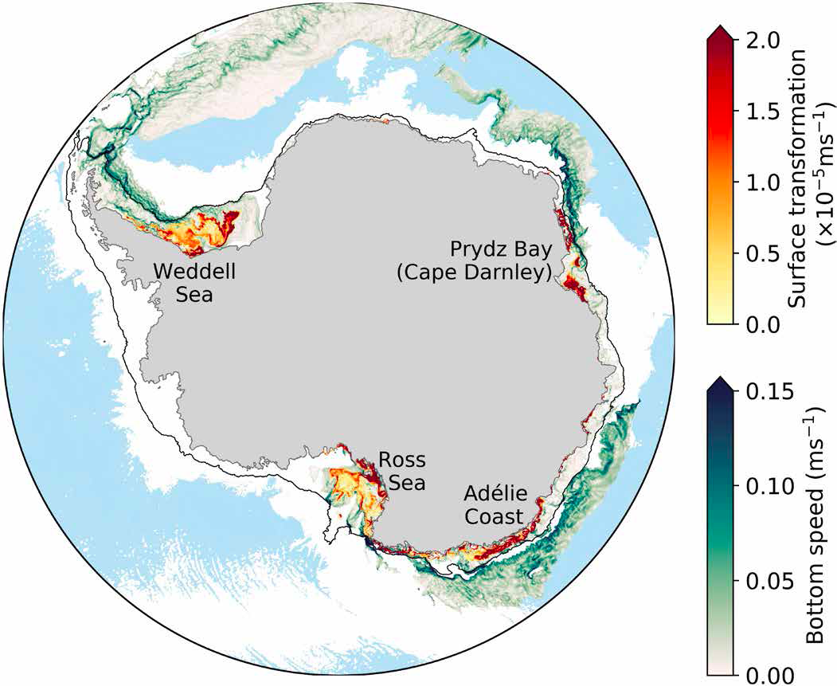
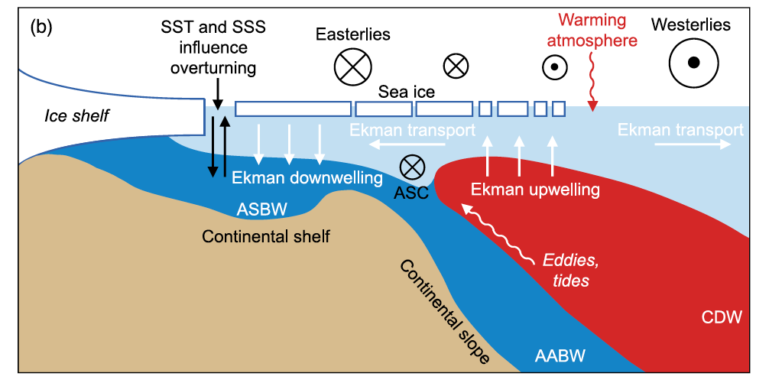
CMIP6-forced high resolution ocean/sea-ice projections
using the ACCESS-OM-01 model
Morrison et al. 2020

Slide 2
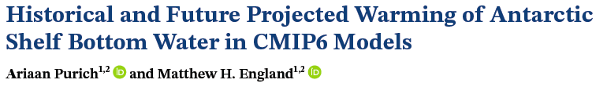
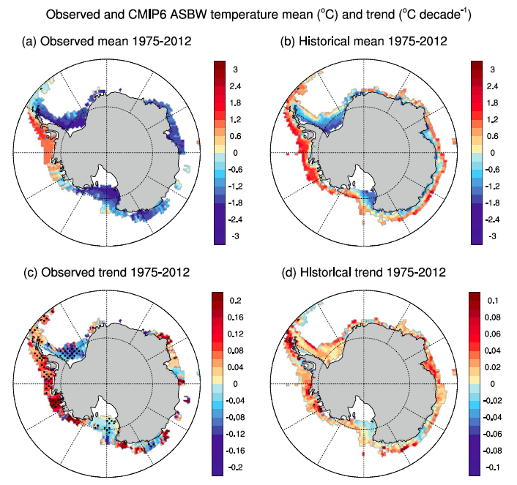
OBS
CMIP6

Slide 3
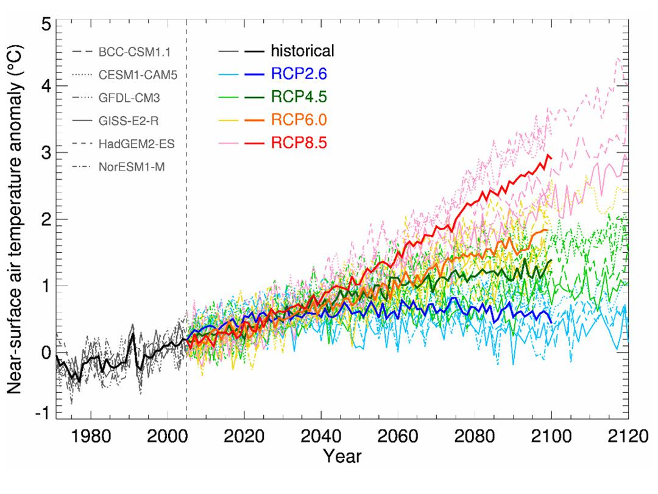
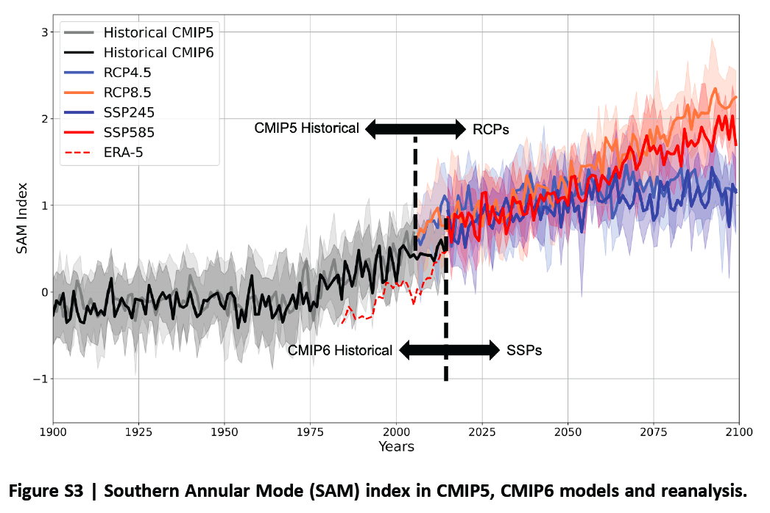
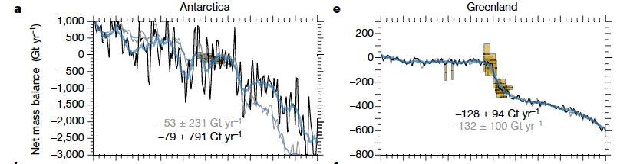
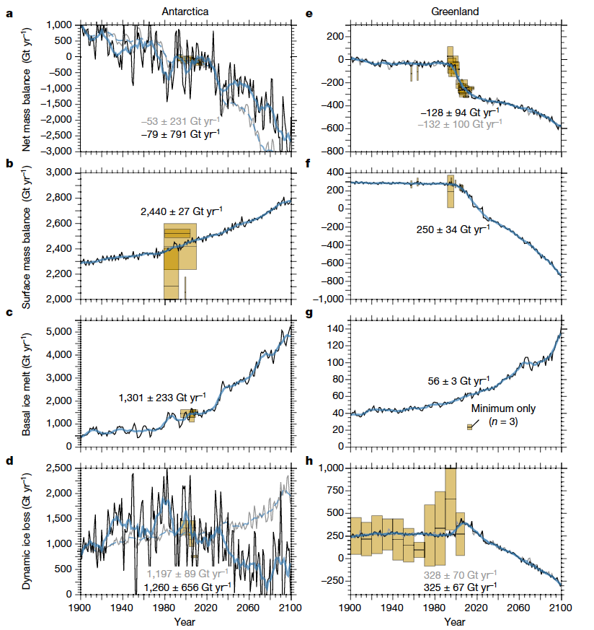
SAM projections
Global SAT projections
Goyal
et al. 2021
Meltwater projections
Greenland
Golledge
et al. 2019
Antarctica

Slide 4
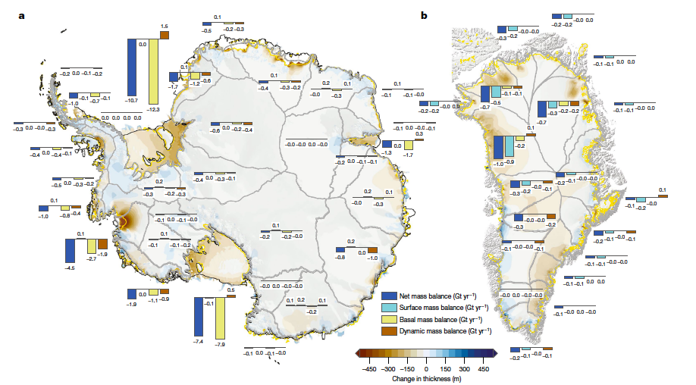
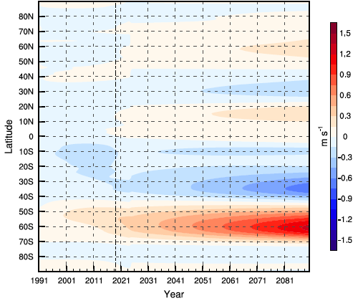
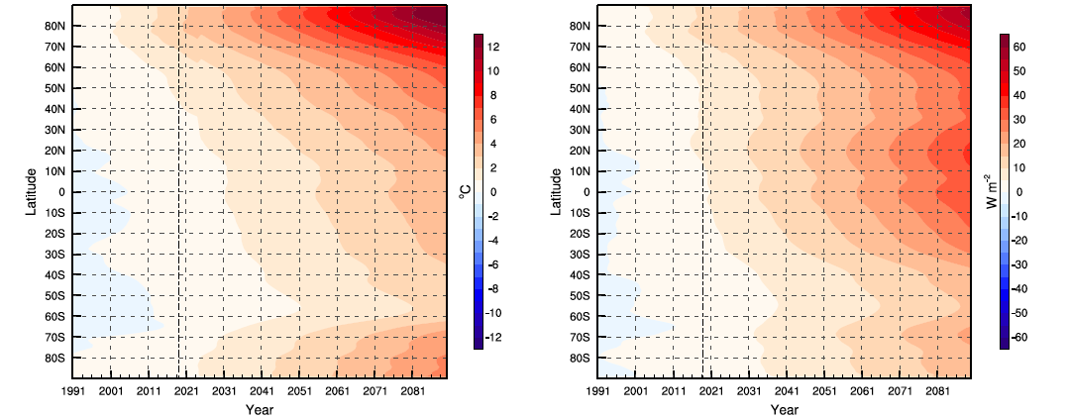
ACCESS-OM-01 model SIMULATIONS:
• Control RYF simulation 1991 – 2100
• Winds + Warming 1991 – 2100
• Winds + Warming + MW 2000 – 2100
→ gradual transient CMIP6 zonal mean forcing
→ run from 2000 – 2100
(run at both 1° and 0.1° resolution)
Meltwater
Golledge
et al. 2019
Surface zonal wind speed
Surface air temperature
Surface LW radiation

Slide 5
Other studies have applied MW anomalies before
Ocean high-res models but via abrupt delta-functions
E.g. Moorman et al., 2019
Transient coupled & ocean models but at coarse resolution
Bronsealer et al., Golledge et al., Lago & England, 2019

Slide 6
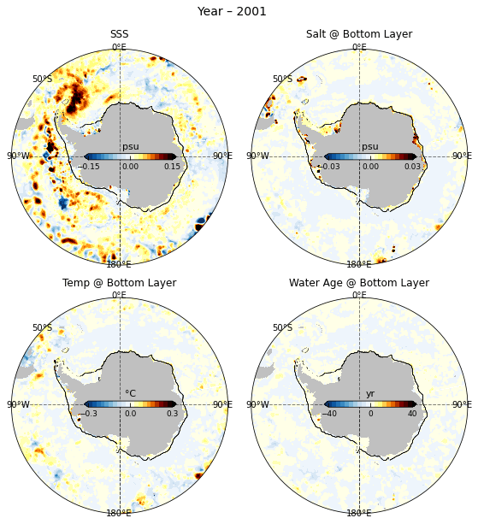

[Winds + Warming + MW]
minus CONTROL
SSS
Bottom salinity
ALL FORCINGS
RESPONSE
WINDS
+WARMING
+MW+
Bottom temperature
Bottom AGE

Slide 7
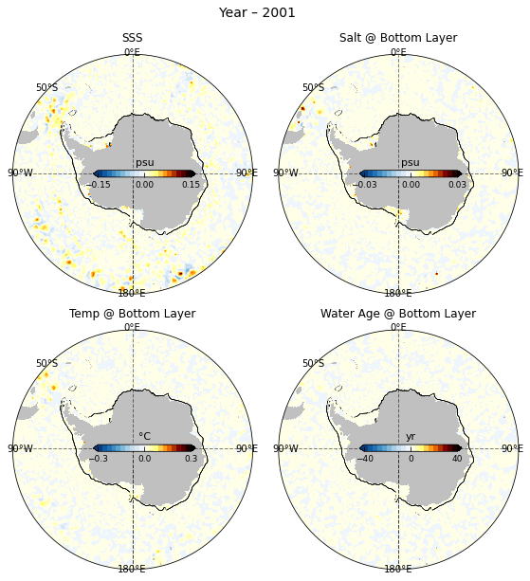

[Winds + Warming + MW]
minus
[Winds + Warming]
SSS
Bottom salinity
MW EFFECTS
ONLY
Bottom temperature
Bottom AGE

Slide 8
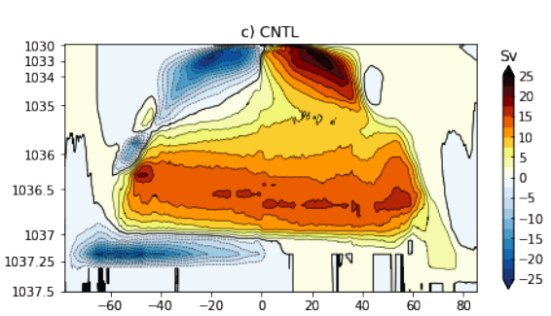
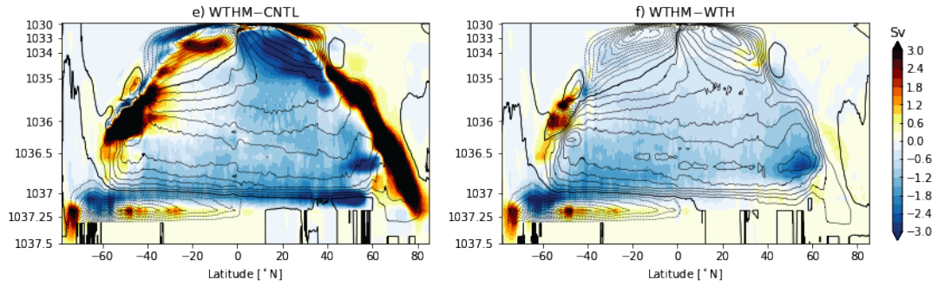
OVERTURNING CIRCULATION
IN DENSITY COORDINATES
AABW CELL
ALL FORCINGS RESPONSE
MELTWATER RESPONSE

Slide 9
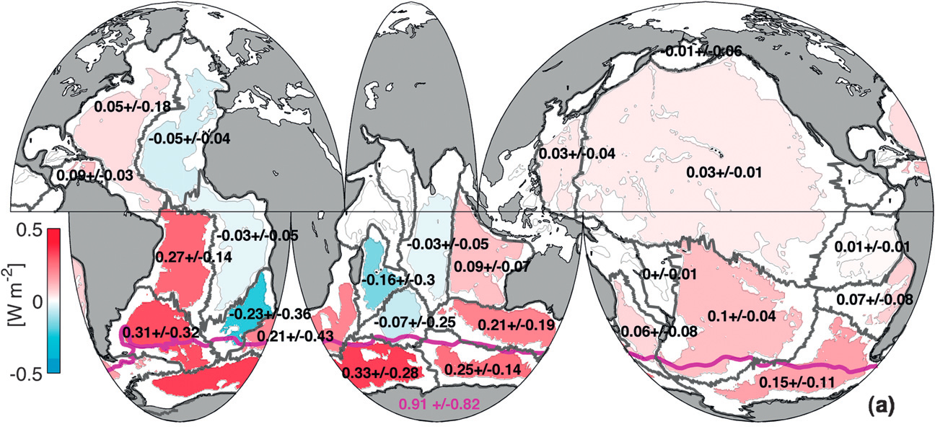
OBSERVED ABYSSAL (>4000m) T CHANGE
2000’s relative to 1990’s
PURKEY & JOHNSON

Slide 10
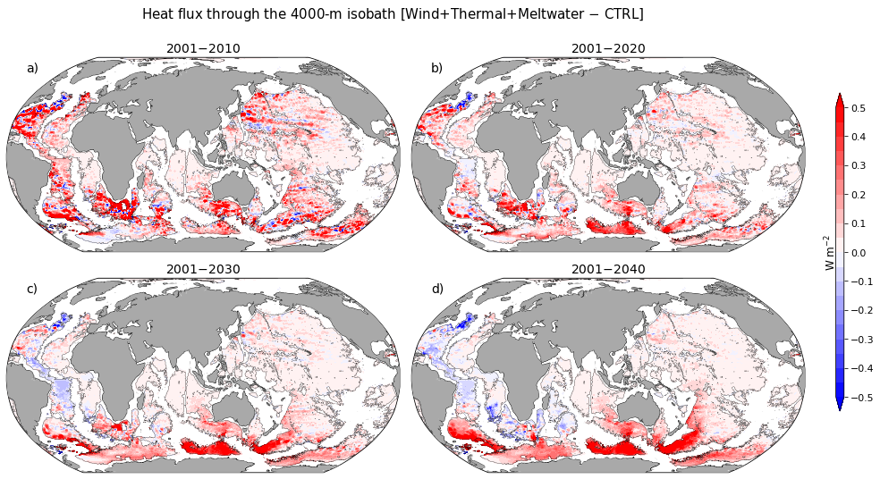
[Winds + Warming + MW]
minus CONTROL
ALL FORCINGS
RESPONSE

Slide 11
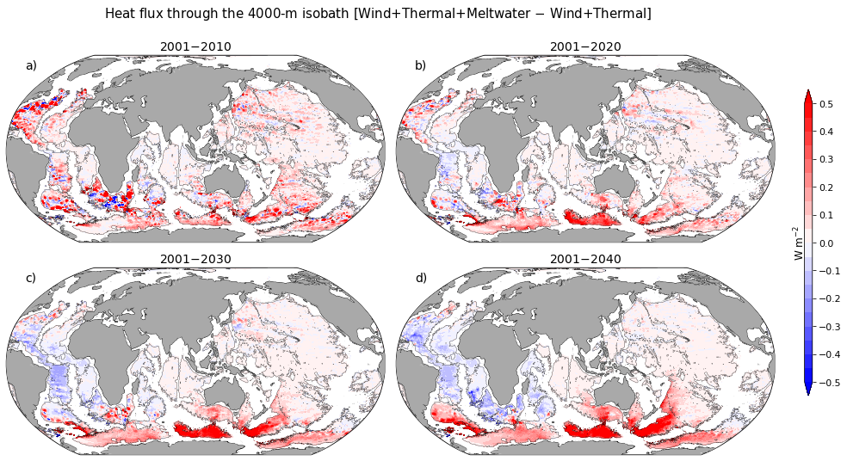
[Winds + Warming + MW]
minus [Winds + Warming]
MELTWATER
RESPONSE

Slide 12
Summary:
New high-resolution CMIP6-forced ocean-sea-ice simulations run out to 2040 (with added MW)
Southern Ocean subsurface warming at high-latitudes – amplifying feedback for ice-shelf melt
Projected AABW warming, freshening, contraction and overturning slowdown

